Slide 1
Basque Fatherland and Liberty (Euzkadi Ta Askatasuna; ETA)
~Gabrielle Baker

Slide 2
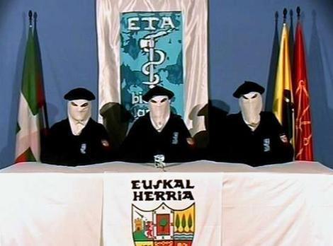
It is typical for the ETA to issue a statement to the Spanish media in groups of 3 with masks such as these.

Slide 3
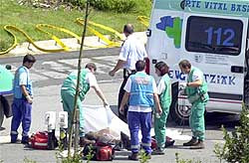

Slide 4
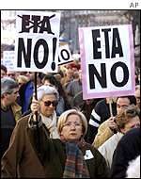
Over 3,000 people can no longer live their daily lives in peace without bodyguards; death threats from the ETA to the people in the Basque Country have been received.

Slide 5
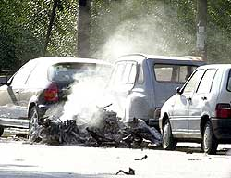

Slide 6
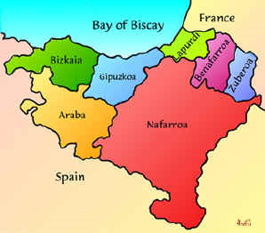
These are “claimed” regions of both Spain and France by the Basque Separatists (ETA).

Slide 7
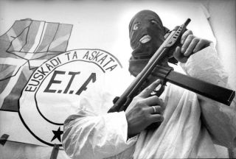
Since 1959, supposedly the ETA has been the cause of over 800 deaths.

Slide 8
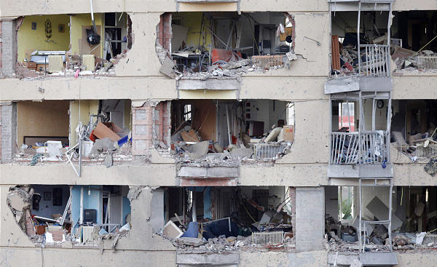
A car bomb containing 440 pounds of explosives was targeted towards the Civil Guard barracks.

Slide 9
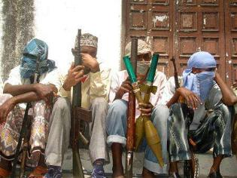

Slide 10
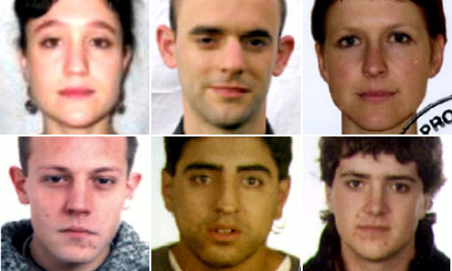
In 2009, these ETA members were held responsible for a series of bombings in Spain.

Slide 11
The ETA’s most common symbol.

Slide 12
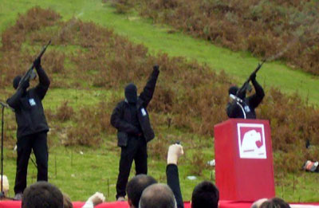

Slide 13
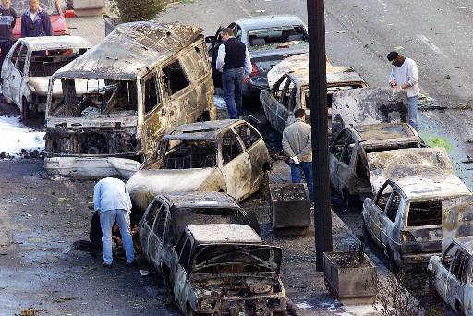
The outcome of yet another car bombing by the ETA in Spain.

Slide 14
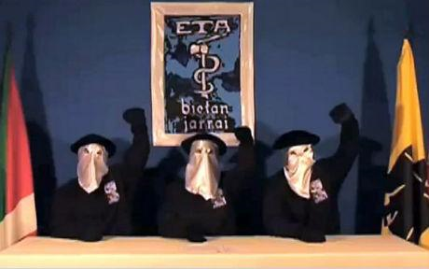

Slide 15
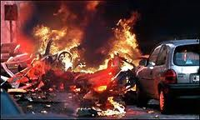

Slide 16
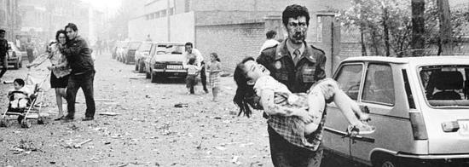
This is just some of the ruthless damage ETA has done through use of explosives.

